Slide 1
ED group project Zap! (E-COMMERCE)
Entrepreneurship Development (2HS309)

Slide 2
team members
Krupal Patel – 20162121007 (BDA)
Ujjval Patel - 20162121021 (BDA)
Nitin Prajapati – 20162121022 (BDA)
Yash Prajapati -20162121023 (BDA)
Jinay Shah - 20162121025 (BDA)
Purav Shah - 20162121026 (BDA)
Rudra Patel – D2D (CBA)
Anuj Jani - D2D (CBA)

Slide 3
The value of success without struggle is zero.

Slide 4
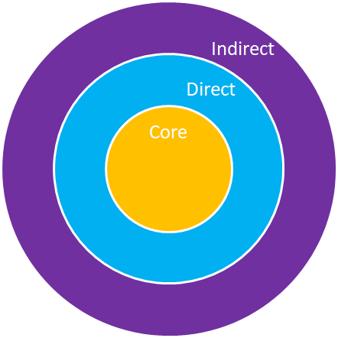
Stake Holder Mapping
- Core SH: Consumer who is interacting with the website
Eg: - Person who wants to buy a phone.
- Direct SH: Influencer of Consumer
Eg: - The one who influences the consumer to buy a phone.
- Indirect SH: Rest are those who do not directly influence the consumer.
Eg: - The One who may or may not influence CORE or DIRECT SH but they are part of the domain

Slide 5
Activities In Problem Space
User doing these activities to buy Product.
User does research about all kinds of Products.
User Select the Product which he/she finds suitable for him/her.
User Compares about Product’s Price all the way around.
User Purchases that product from the website which gives discounts/offers to the User.

Slide 6
Process System
Process of receiving orders
Customer places an order in your eCommerce system
Order details are extracted from your eCommerce system and entered into your business software
Order is passed to the warehouse to be processed
Order is placed for fulfilment

Slide 7
Process System
Sub Process of receiving orders
Sales order details are manually extracted from your eCommerce system. Information includes customer information, description and ID of product ordered, payment details and transaction ID
Employee manually checks sales order data for a correlation with your business rules e.g. full address, contact details, products ordered
Employee manually enters order and customer details into your business software
Employee manually creates and sends an order received notification to the customer
If an employee identifies any anomalies they will need to contact the customer to resolve the issue
If an issue cannot be resolved the employee may have to manually cancel the order
Order is passed to warehouse for processing

Slide 8
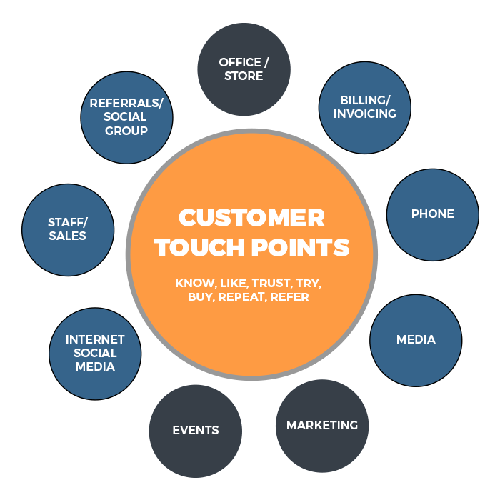
Customer Touch Points
We can attract users through various social media platforms by advertising our products.
We can give brochures to the people in the street to advertise our products.
We can advertise on television,radio etc.
We can give goodies or more discounts to the users.
We can give faster delivery to the user.

Slide 9
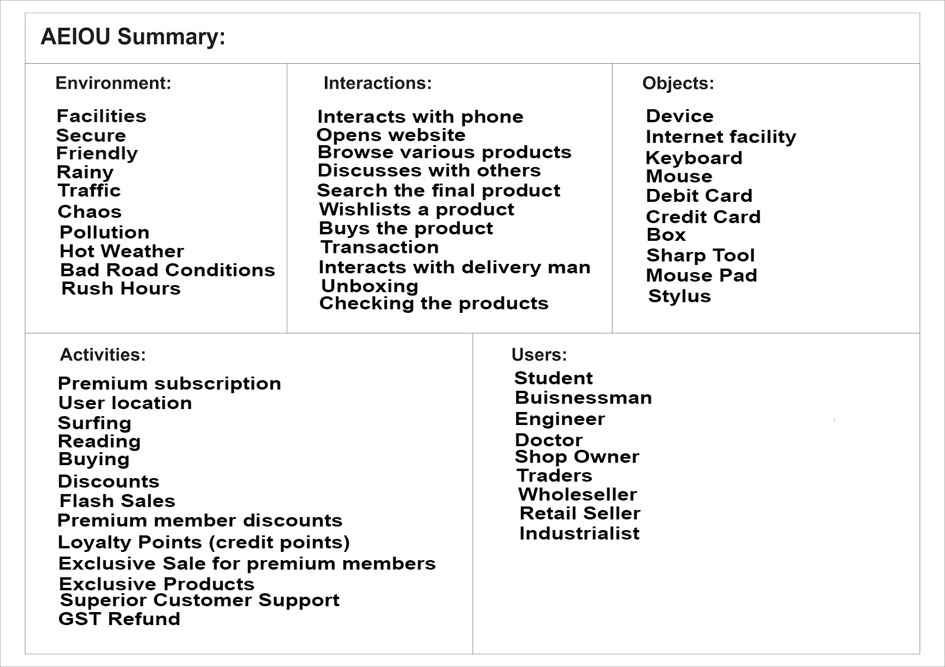
AEIOU Canvas

Slide 10
5 Deep Insights
User doing these activities to buy Product.
User does research about all kinds of Products.
User Select the Product which he/she finds suitable for him/her.
User Compares about Product’s Price all the way around.
User Purchases that product from the website which gives discounts/offers to the User.

Slide 11
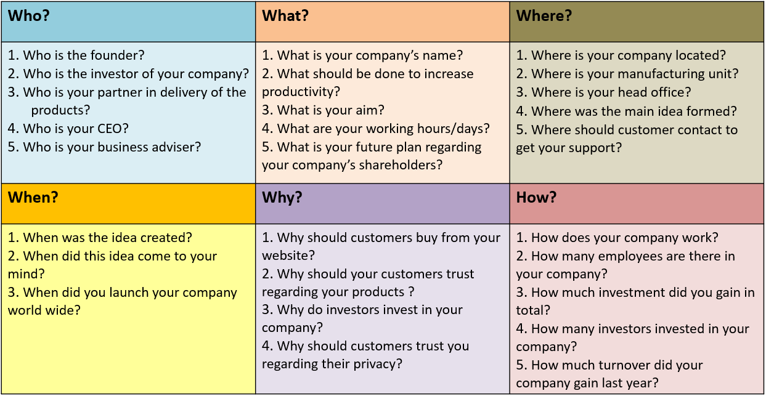
The 5W & 1H of Kaizen

Slide 12
Persona-1
Name: Ujjval Patel
Age: 18
Profession: Student
Interest: User come to our E-Commerce website spend time to search for the respective product. He shows interest in our product.
Powers:
After ordering the product if the user did not like the product then he/she can return the product with in 1 month of Delivery
If the product is returned or if the product is defective the user gets his money back.
Needs:
According to user needs we sort our products and show the them products which they want.
As Security and privacy is basic and most important need of a user.
Our website also ensures that the product needed by him must be available so that he/she should not worry and have to go to another place to search for it.
With the options of net banking we also provide user Cash on delivery facility which is also a need of user.
Behaviour:
We track the behaviour of the user on which type of product the user shows the interest and show them such products in recommendation.
Values:
Best Products
Best after market services
Fastest delivery
Compensation is given to the user by giving discount coupon if prior product is defective or due to late delivery.
Aspiration:
Whatever brands he searches or he likes or he buys, we recommend them.
Secure payment method

Slide 13
Persona-2
Name: Krupal Age: 18
Profession: Student
Needs:
So our website can show those product which user wants
Security ->most important needs of every user is security. Means our website can provides ,
Product availability , safely delivery
Powers :-
User get power on product delivery whatever place
All product available on 1 platform
Ability to control data of user and they give track or information about product
Interest :
Using AI we can find out User interest
So our website can show the product Of user interest
Behaviour :
They tract the user behaviour
Which product they search and there interest and need , etc.
Values :-
Best services
Cheapest price
Product quality
Security
Door to door service
Aspiration :-
Most search brand -> recommendation
Secure home delivery
Secure payment method

Slide 14
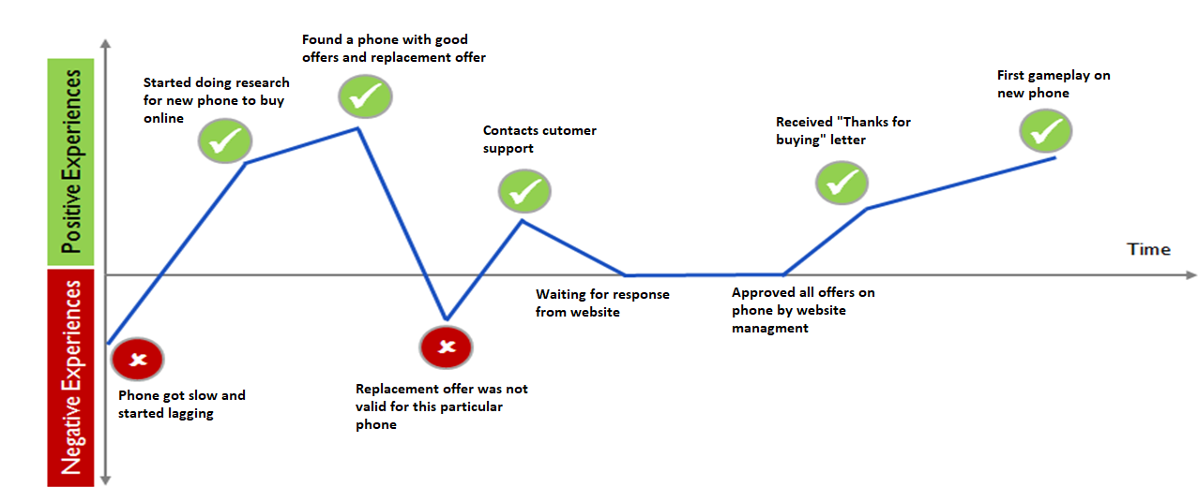
Customer-1 Journey Map

Slide 15
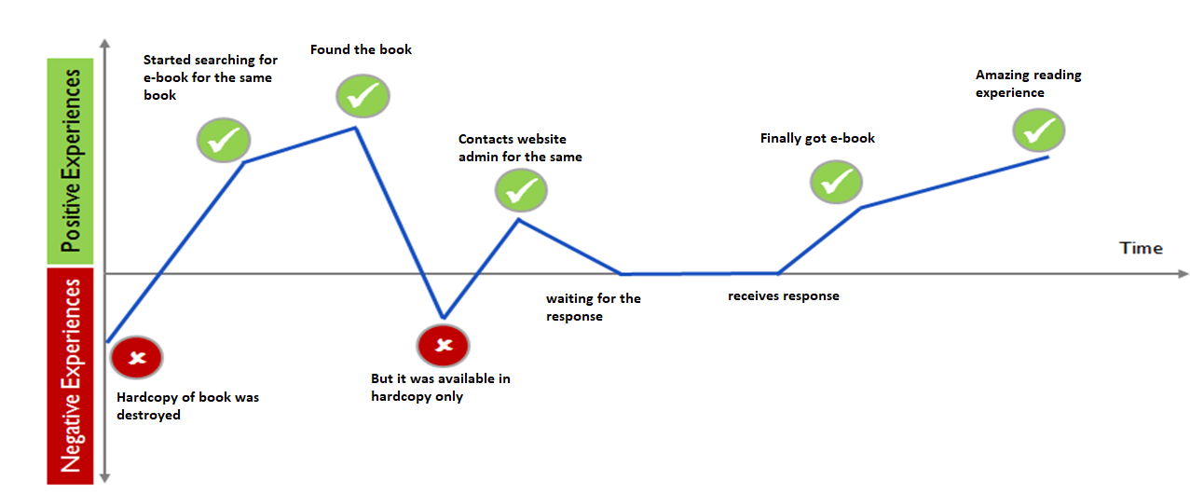
Customer-2 Journey Map

Slide 16
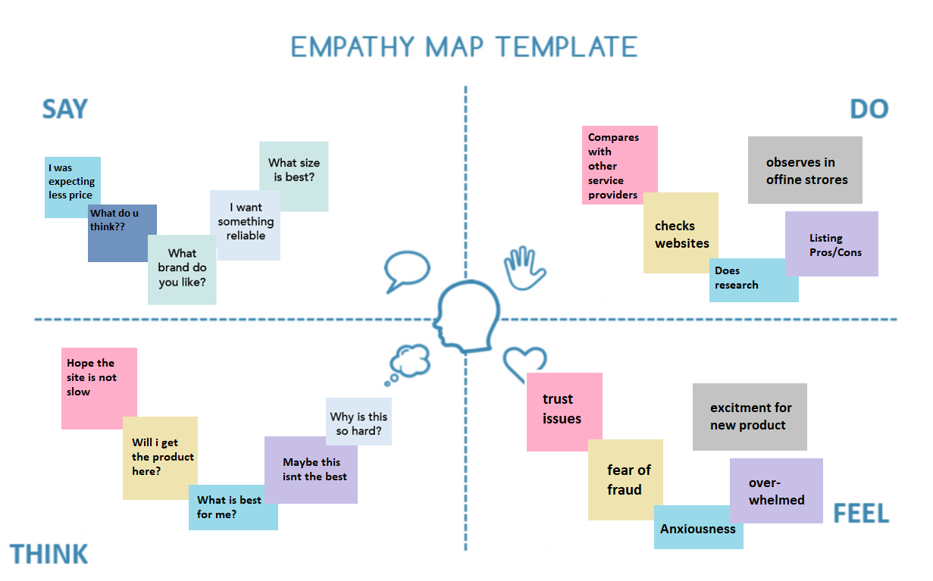

Slide 17
40 ideas using tools & techniques of ideation
Brainstorming:
Improving user interface so that user feels comfortable on website
There are problems related payment so we included payment gateway so that online payment as well as cash on delivery can also be done
Return policy is made flexible for users
Fast delivery
Discount
Free shipping anywhere in the world became possible through raised funding

Slide 18
Brainstorming :
we sell only trusted brand product.
Scratch & Win for customer benefits like Cashbacks / lucky draw
Exclusive Discounts (on festivals )
Delicate items are delivered carefully
Privacy is maintained
Authentic products are available

Slide 19
Brainstorming:
Custom delivery timings according to users choice
App and website are synchronized
Many e commerce shopping apps is not supported on all phones but or app is supported on every phone
Customer can contact to delivery man regarding any query in delivery

Slide 20
Divergent Thinking:
Language barrier problem solved by adding all native languages
Slow loading in website is a problem so that we have also launched or mobile application
Responsive website and mobile application
Member Loyalty Programs
Subscription Programs
Promote Made in India

Slide 21
Divergent Thinking:
Filter according to product type,price etc.
Exchange offer on products
Any seller can sell his/her products using our website as a medium
Selling of Second Hand Products is also available
Our website consist of negligible number of adds so that user doesn’t get annoyed
App takes very less time to start

Slide 22
Lateral Thinking (SCAMPER):
Modification are done so that low bandwidth problems are solved(Tool used:M – MODIFY/MAGNIFY)
Delivery issues solved (Tool used:R – REVERSE/REARANGE)
Image loading speed increased (Tool used:S – SUBSTITUTE)
Improved customer service (Tool used:S – SUBSTITUTE)
Improved customer support (Tool used:S – SUBSTITUTE)
Live Order Tracking is available (Tool used:A – ADAPT)

Slide 23
Lateral Thinking (SCAMPER):
Updated Refunding policy (Tool used:M – MODIFY/MAGNIFY)
Products are kept updated (Tool used:P – PURPOSE)
New Products are available as soon as they are available
(Tool used:A ADAPT)
Delivery during crises are also available which is faster in comparison to other e commerce websites (Tool used:A – ADAPT)
Special discount is offered to students if shopping is done through institute email id (Tool used:P – PURPOSE)

Slide 24
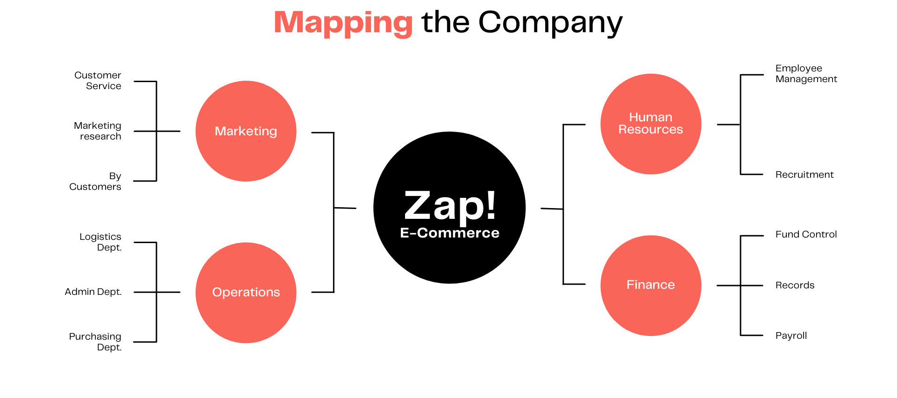
Mind-Map

Slide 25
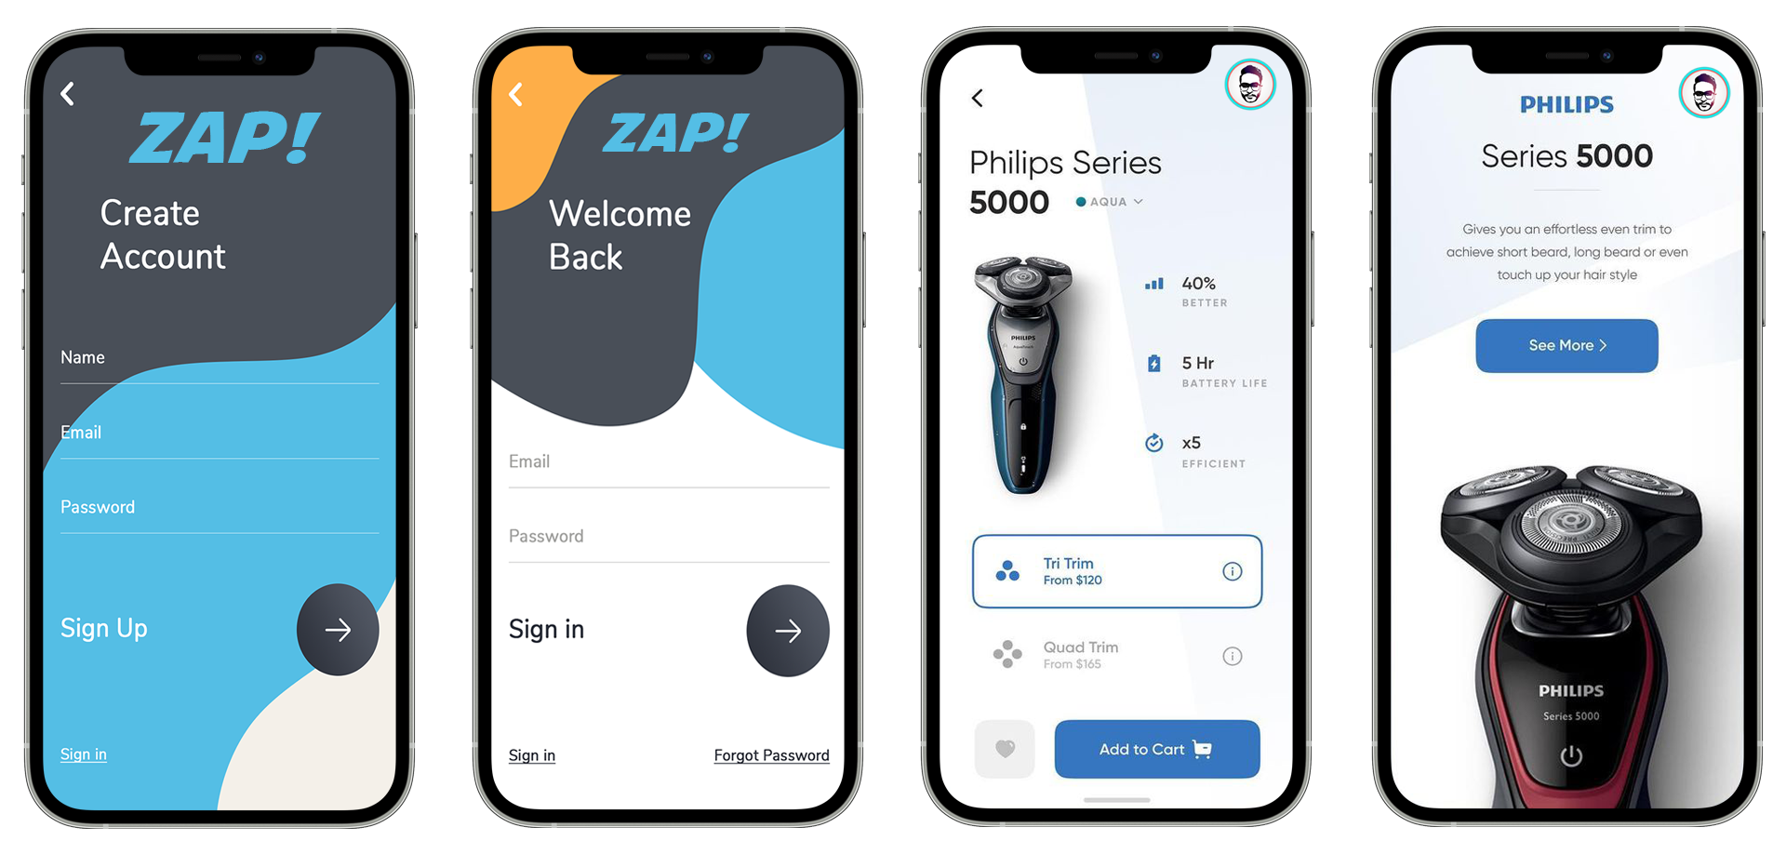
Prototype - 1

Slide 26
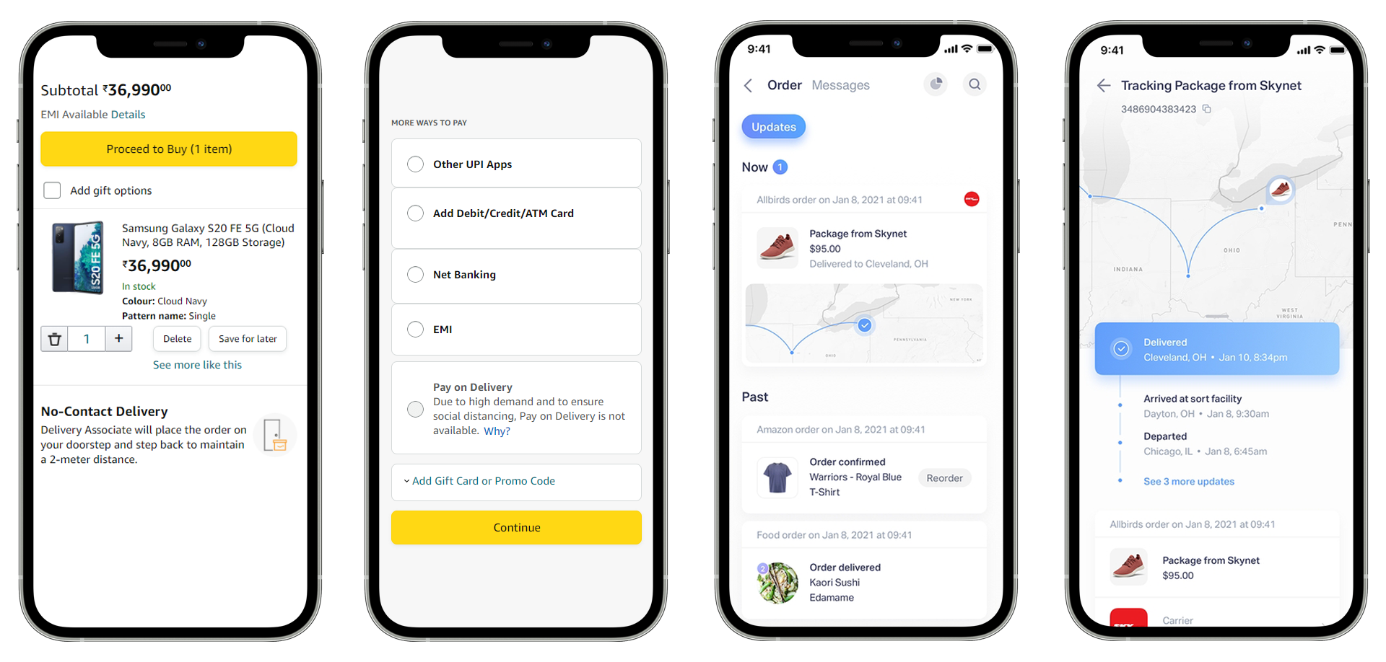
Prototype - 2

Slide 27
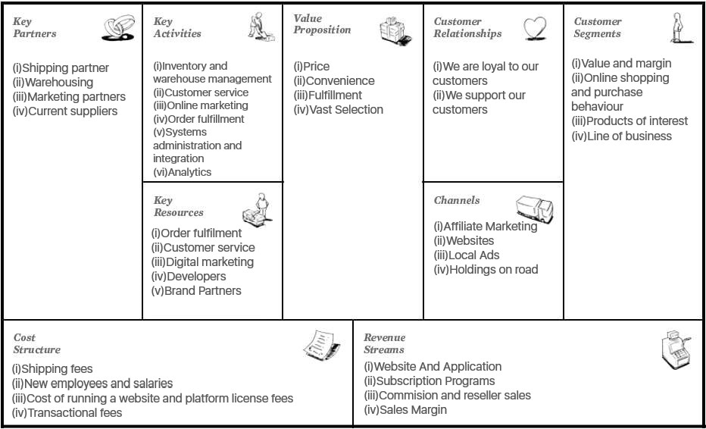
Business Model CANVAS

Slide 28
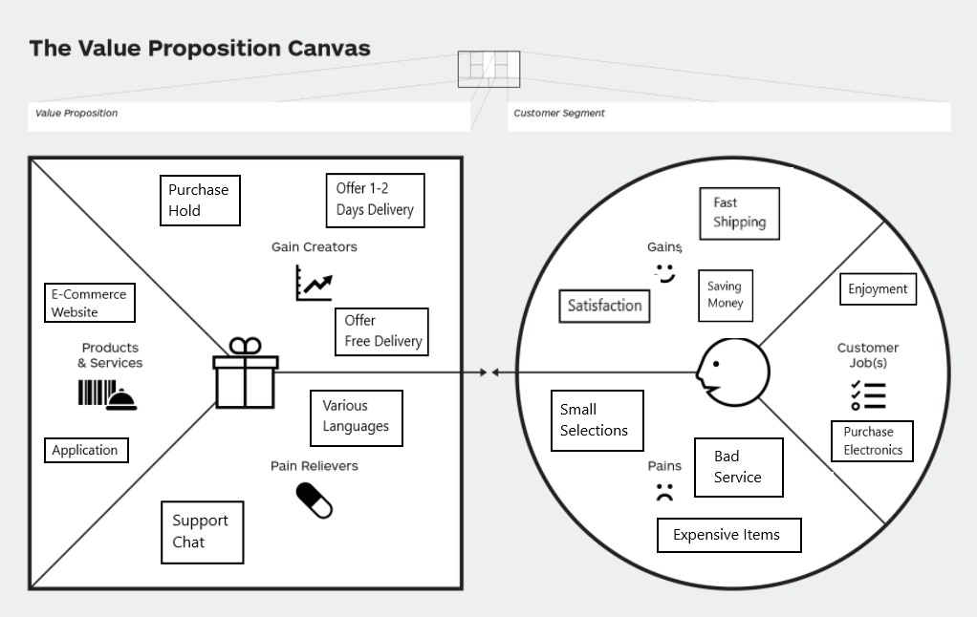
Value proposition CANVAS

Slide 29
thank you !!

